Slide 1
Micro-Scale Logic Gates in Computers
AP Computer Science Principles
Jacques Jiao, July 5, 2024

Slide 2
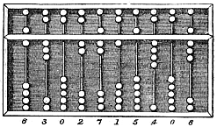
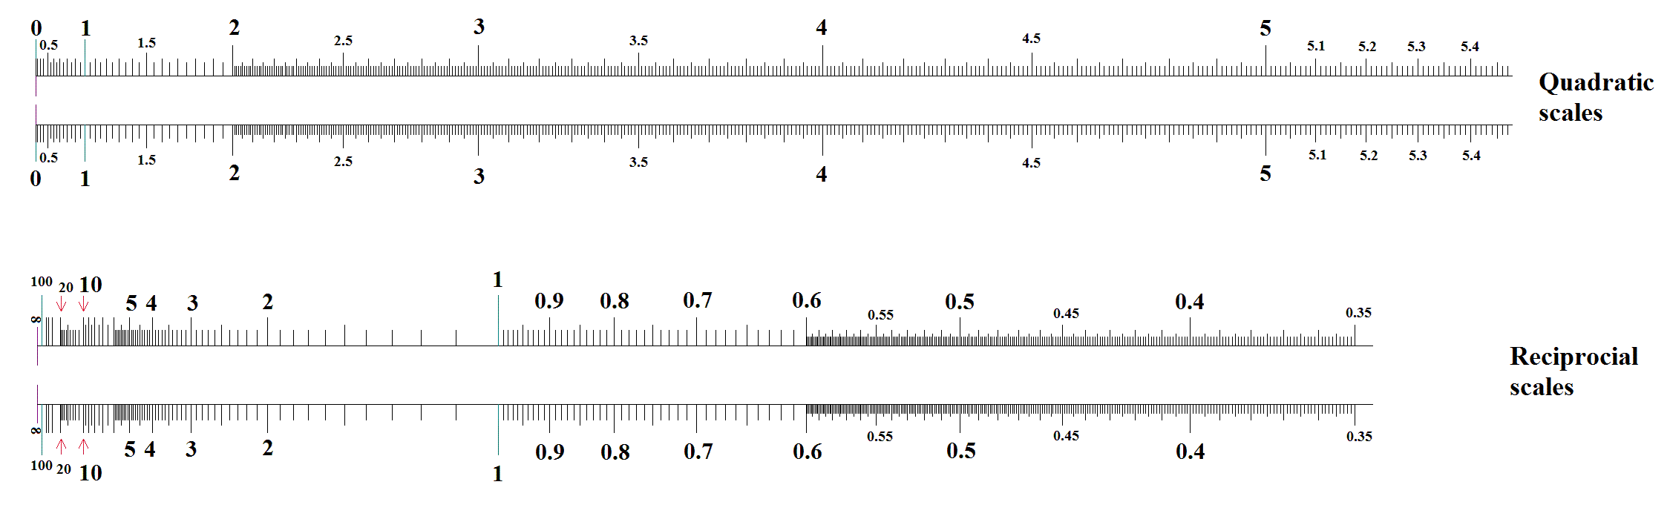

Slide 3
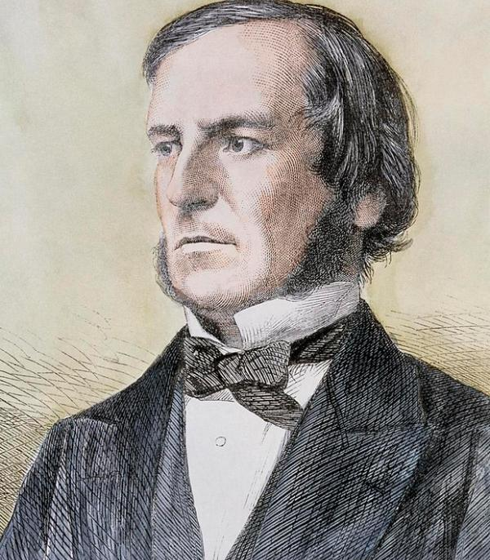
George Boole Jr.
1815-1864
FRS
English mathematician, philosopher, and logician
The Laws of Thought

Slide 4
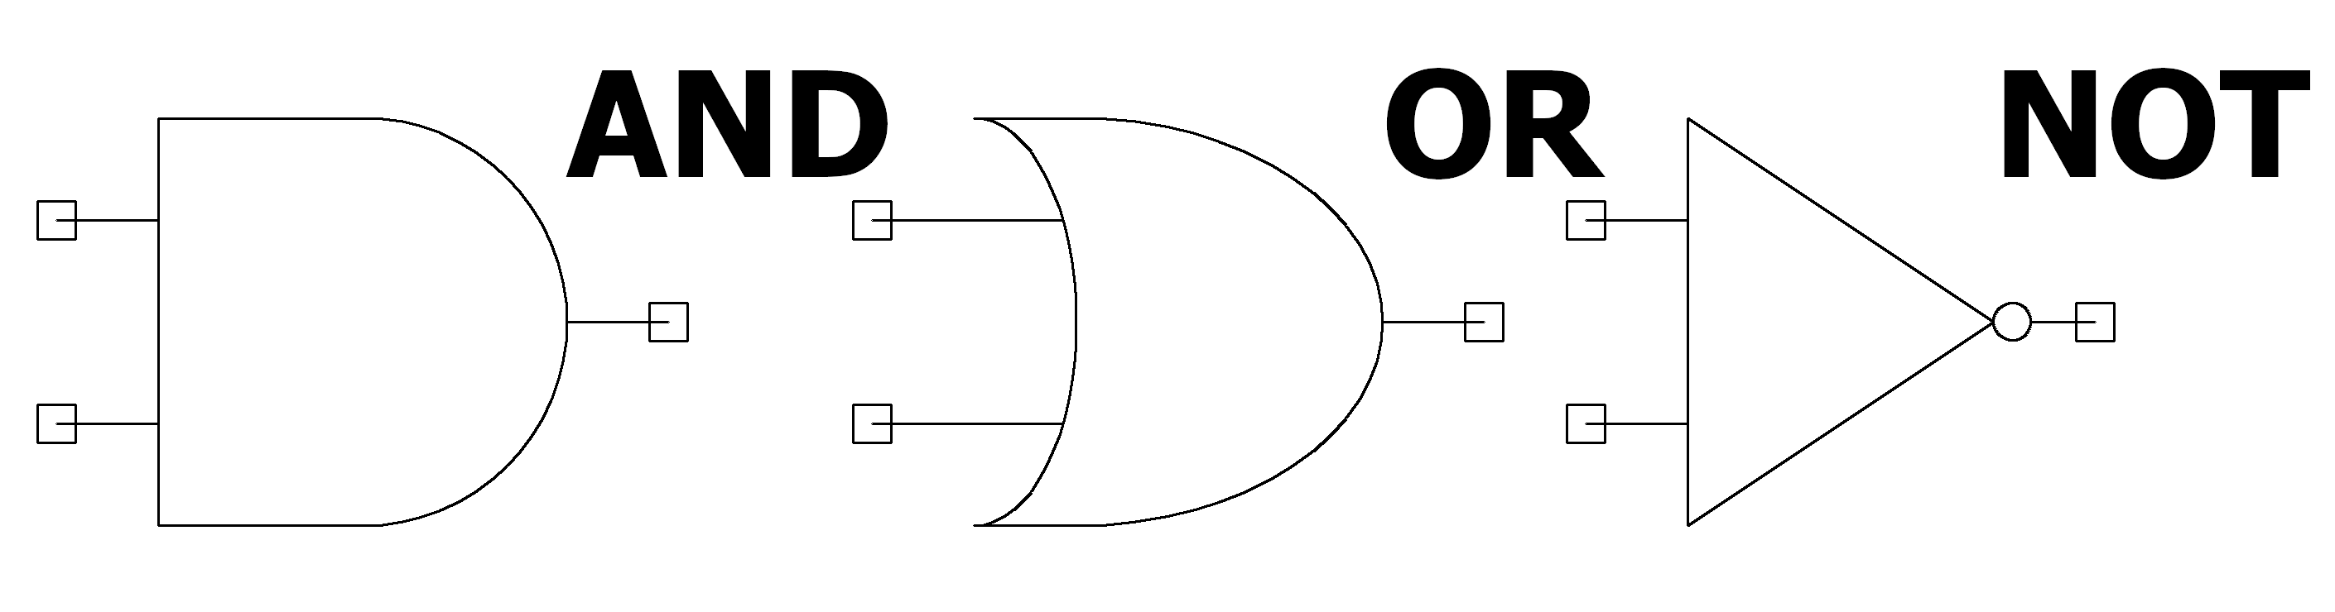

Slide 5
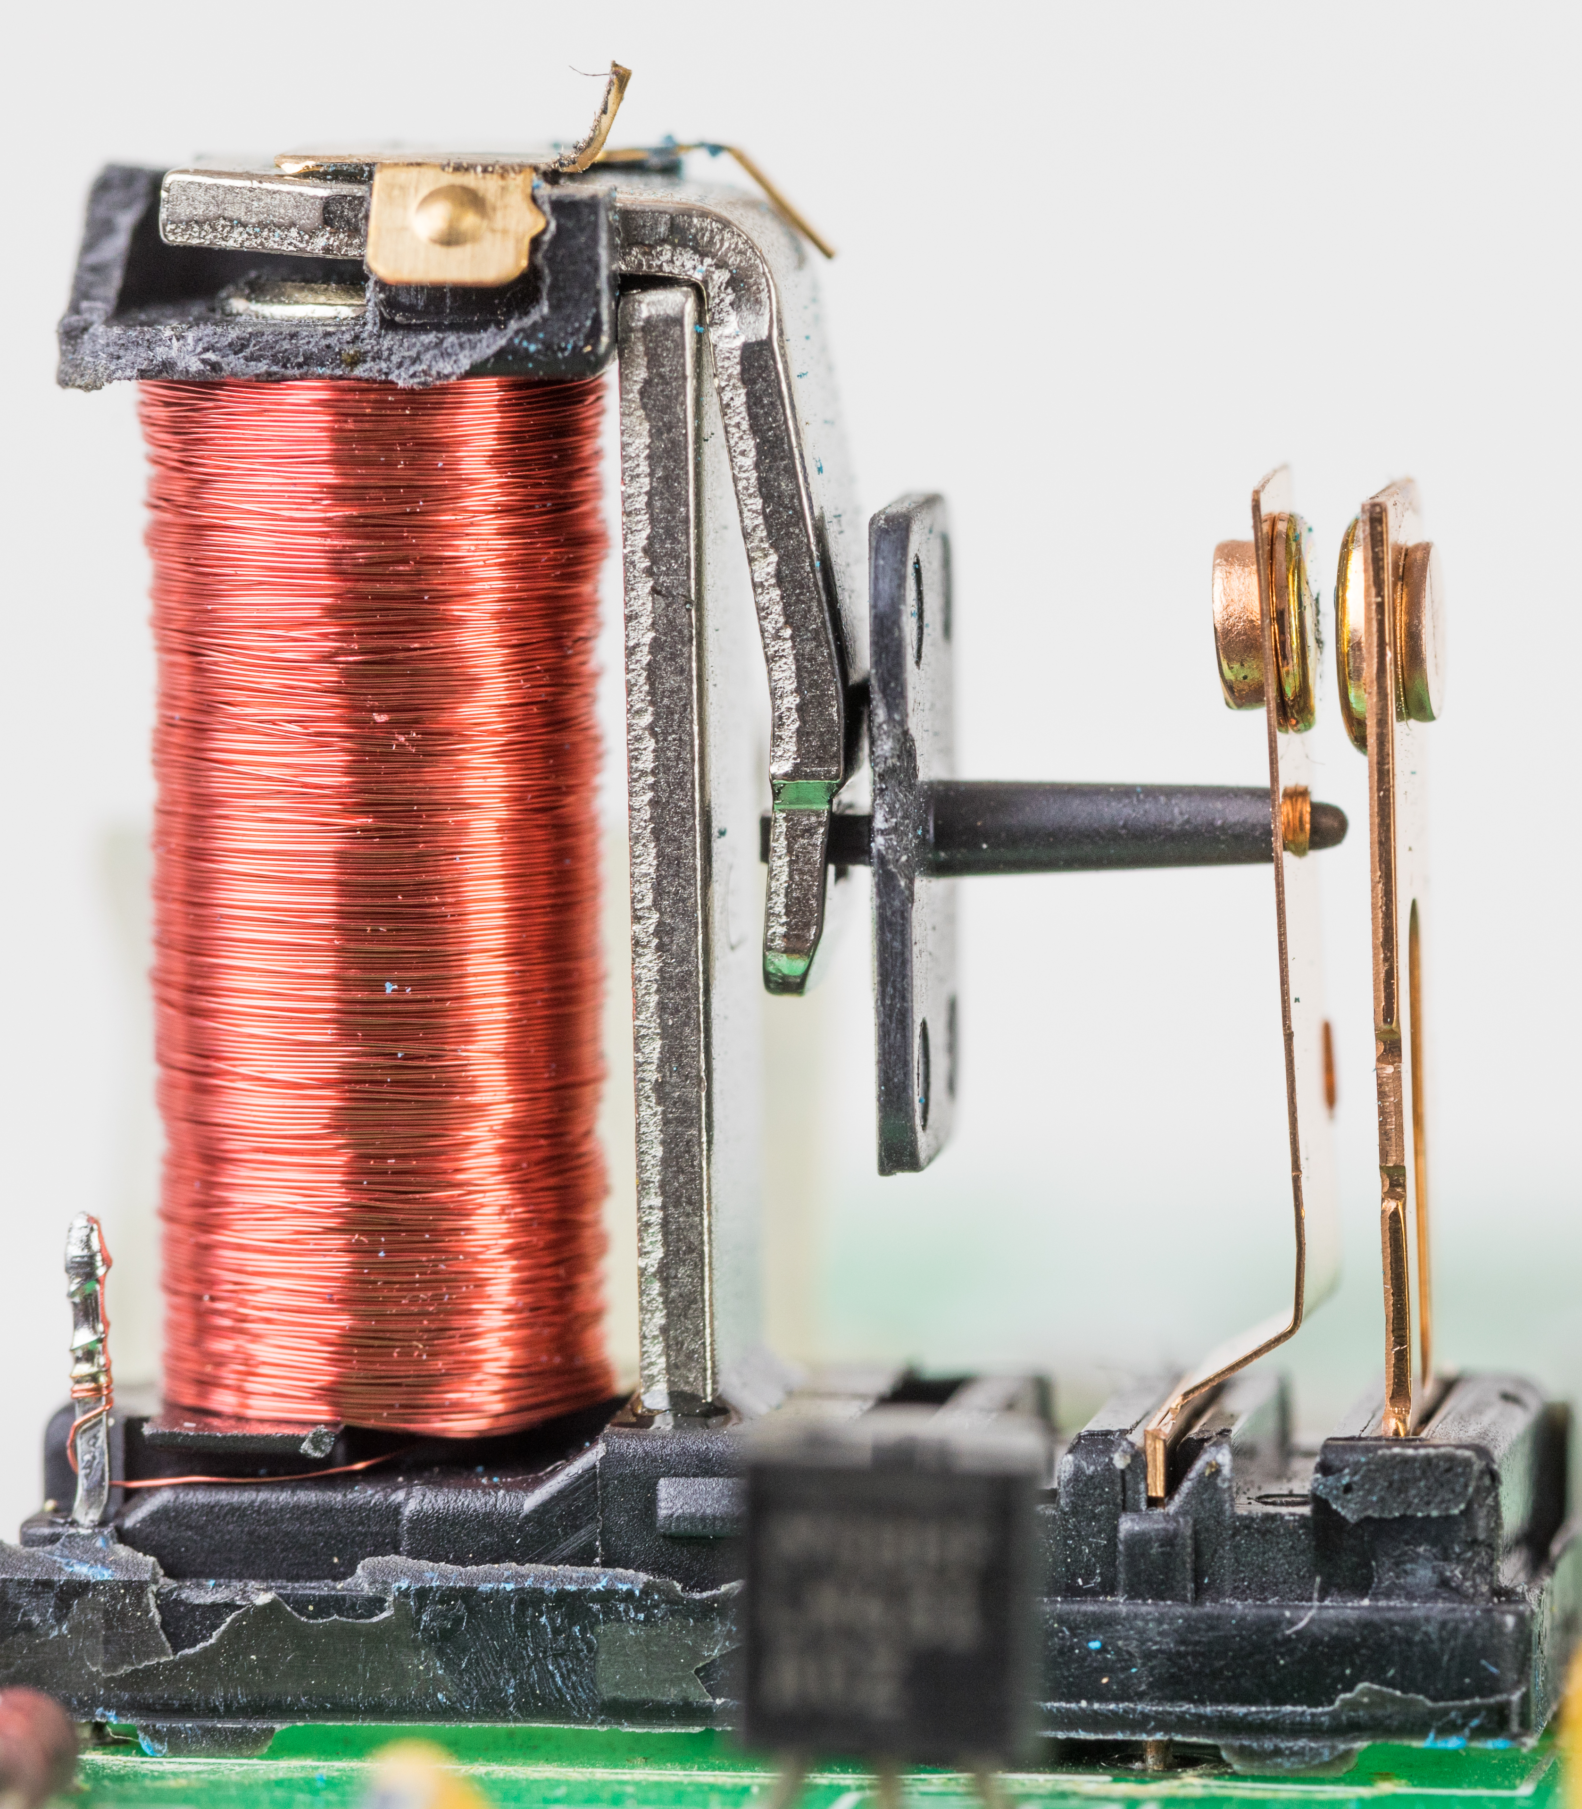
Relay
A Symbolic Analysis of Relay and Switching Circuits
Harvard Mark I

Slide 6
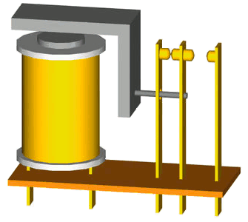

Slide 7
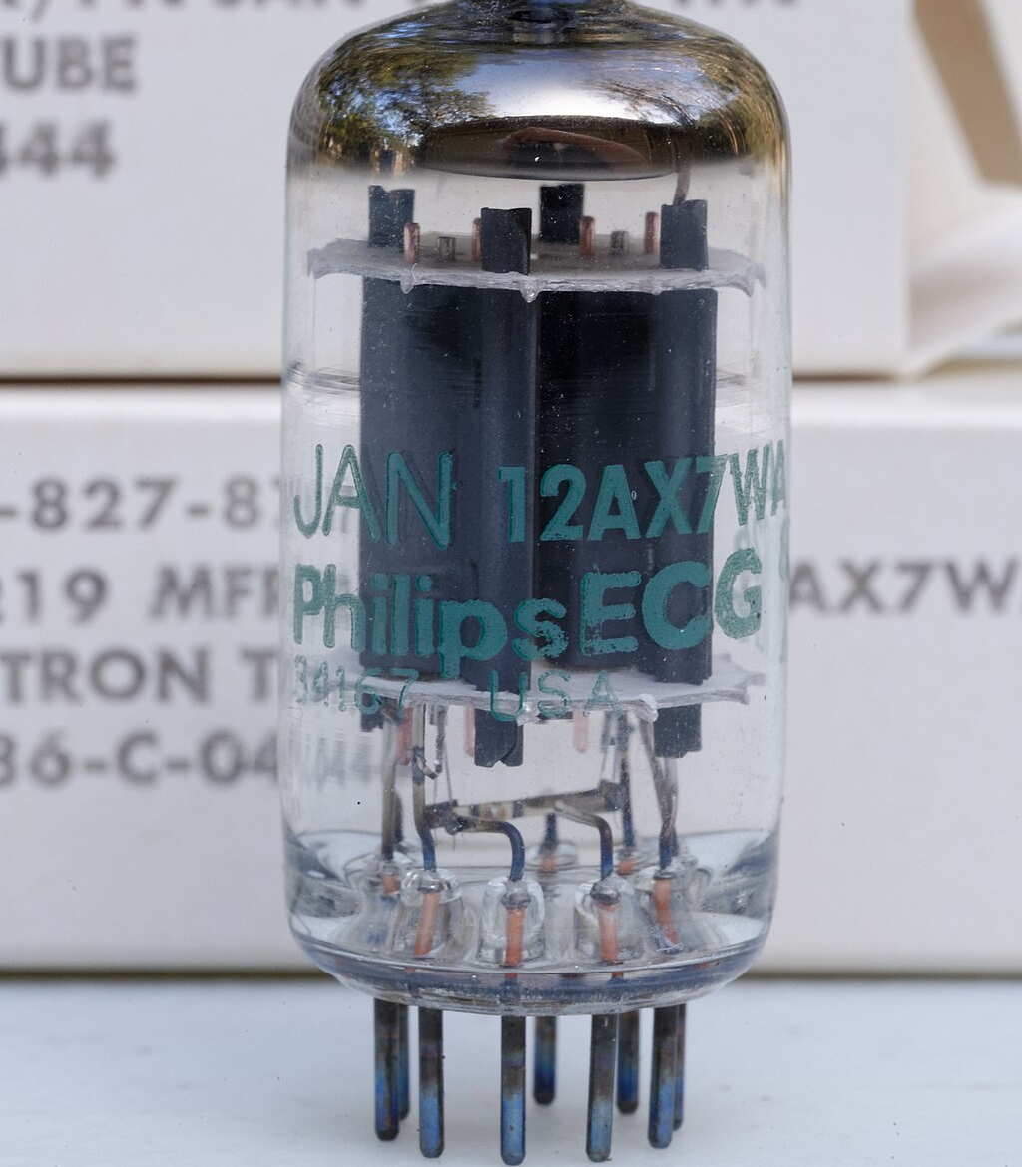
Triodes
First Generation
Lee De Forest
ENIAC (1945)

Slide 8
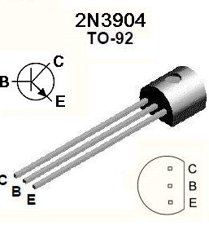
Bipolar Junction Transistor
Second Generation
University of Manchester's experimental Transistor Computer (1953)

Slide 9
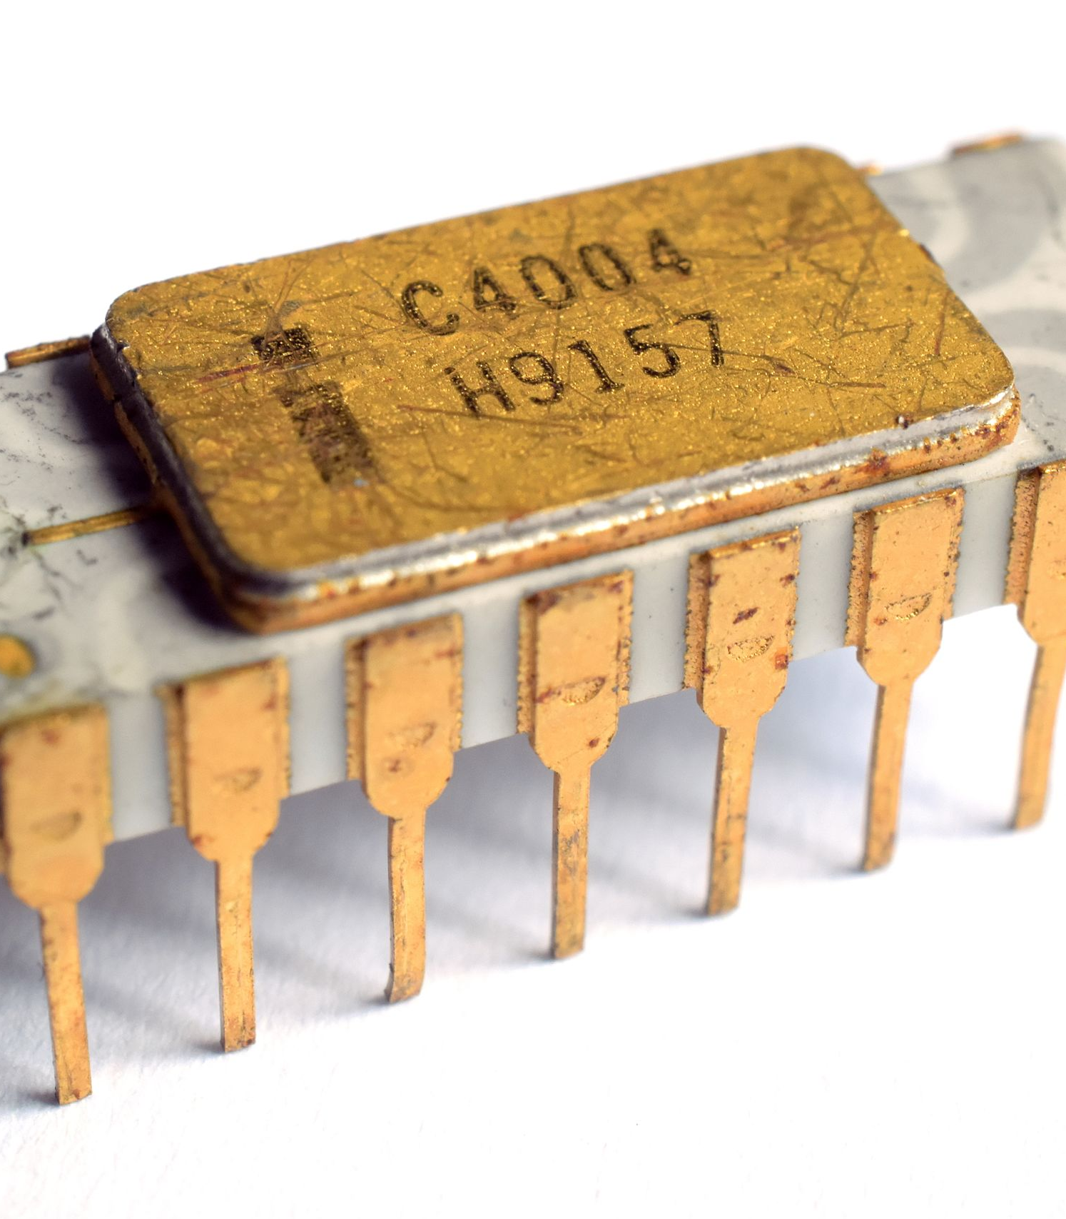
Integrated Circuit and Microprocessors
Third & Fourth Generation
Field-effect transistors(FET)

Slide 11
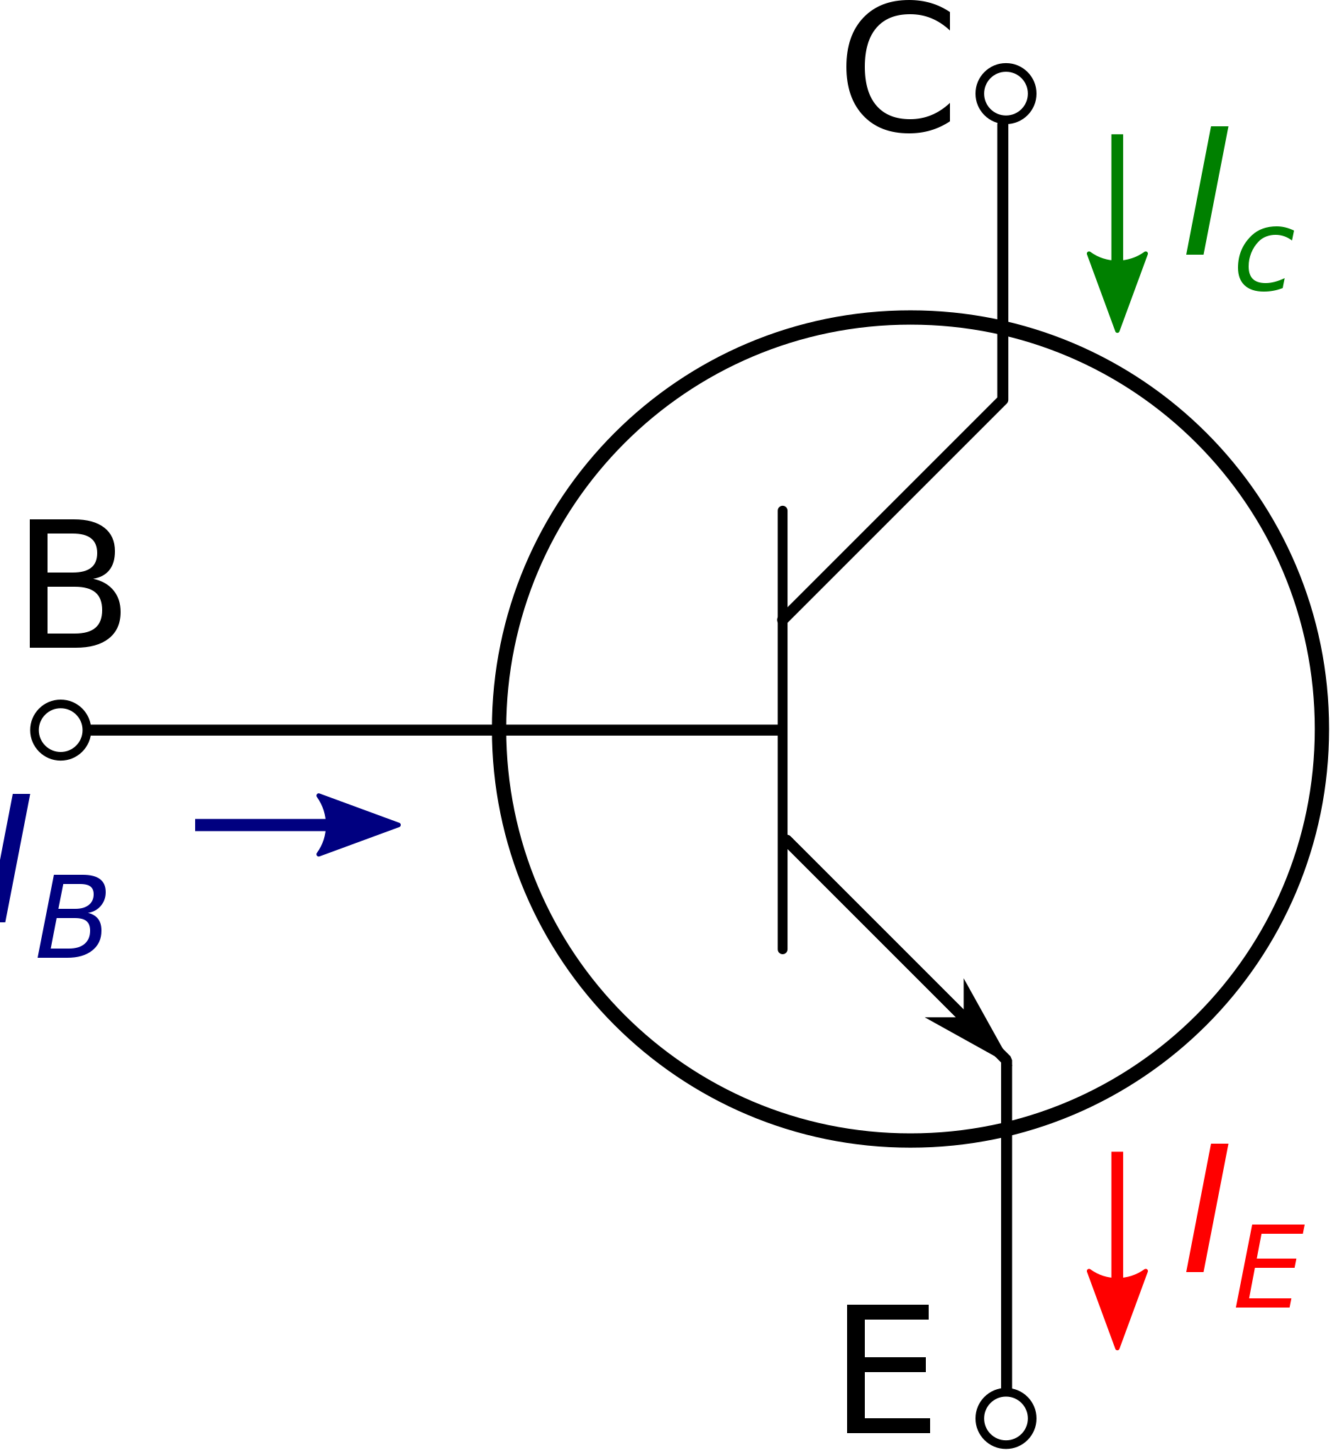
BJT
NPN Type

Slide 17

Thank You!
Micro-Scale Logic Gates in Computers
Jacques Jiao, July 5, 2024

